Slide 1
68
Discrete Mathematics
Modeling with Recurrence Relations

Slide 2































Slide 3













Slide 4






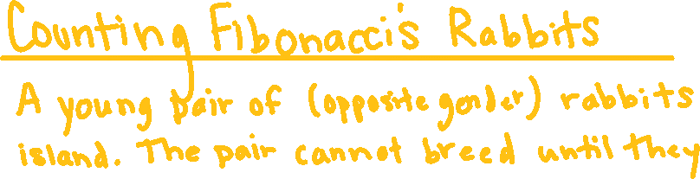



Slide 5


Slide 6




Slide 7




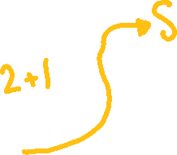

















Slide 8









Slide 9
Up Next…
Principle of Inclusion-Exclusion

